Slide 1
Advanced Computational Methods in Geotechnical Engineering
Lecture
March 26, 2009

Slide 2
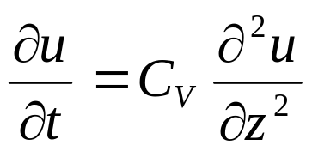
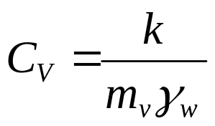
2. FD Solution of Terzaghi’s Consolidation Equation
- The governing 1D Consolidation equation is:
Where, u is the excess pore water pressure, C_{V} is the coefficient of consolidation, z is the depth and t is time.
- The above equation allows us to predict the change in excess porewater pressure at various depths within the soil with time.

Slide 3
We need to know the excess porewater pressure at a desired time because we have to determine the vertical effective stress to calculate the consolidation settlement.
Solution of the 1D consolidation equation can be found in two ways:
Based on Fourier series expansion
Based on Finite Difference Scheme.

Slide 4










- We will use Taylor’s Expansion Theorem.
- First divide the domain into depth – time grid.
- Columns: time divisions & Rows: soil depth divisions.

Slide 5
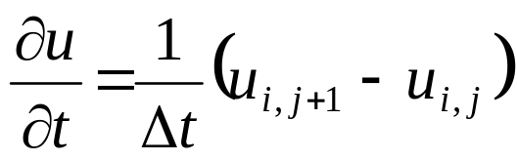
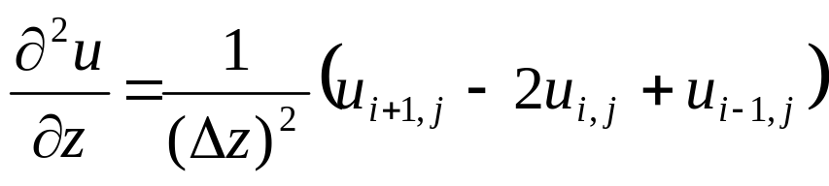
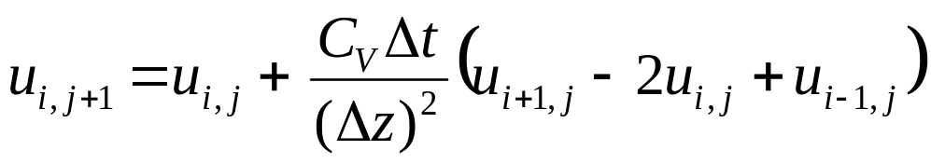
- Applying Taylor’s series expansion to Terzaghi’s eqn.
(2.1)
- Equation (1) is valid for non-boundary nodes.
- Special conditions apply to boundary nodes.

Slide 6
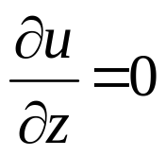





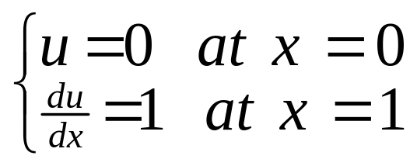
- For example, at an impermeable boundary, no flow across it can occur and, consequently:
Neumann Boundary
Install an imaginary node
Dirichlet
Neumann

Slide 7
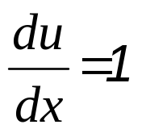
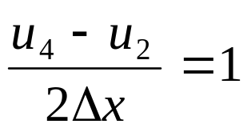
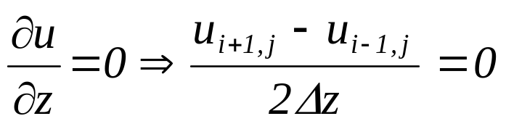

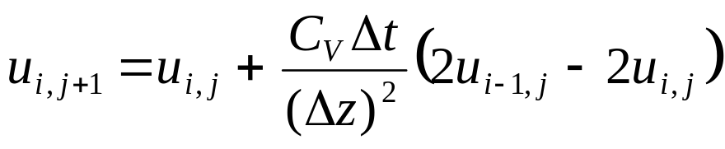
-FDE at node 3:
- The FDE at an impermeable boundary is, thus:
-And the governing consolidation equation becomes:
(2.2)

Slide 8
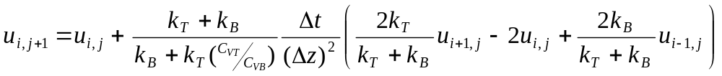
※ Initial u distribution:- required to be determined first.
- For a layered soil with different k and C_{V}, Scott (1963) proposed the following FDE equation:
where suffix T and B stand for top and bottom layers.

Slide 9
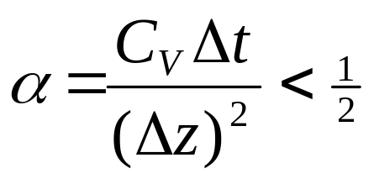
2.1 Procedure to apply FDM to 1D consolidation problem
1. Divide the soil layer into a depth-time grid. Care must be taken in selecting Δt and Δz. For numerical convergence, researchers have proposed the following:
α = 0.25 usually ensures convergence
2. Identify the boundary conditions. If the boundary is a drainage boundary, u is zero. If, however, the boundary is an impervious boundary, then no flow can occur across it and Eqn (2.2) has to be used.

Slide 10
3. Estimate the distribution of initial u.
4. Calculate u at interior nodes using eqn. (2.1) and at impermeable boundary nodes using eqn. (2.2). If the boundary is permeable, then u is zero.
EXAMPLE 2.1

Slide 11
Table E2.1
Column | 1 | 2 | 3 | 4 | 5 | 6
Depth | Time (yr)
 | 0.00 | 0.1 | 0.2 | 0.3 | 0.4 | 0.5
0.0 | 0.0 | 0.0 | 0.0 | 0.0 | 0.0 | 0.0
1.0 | 78.0 | 57.0 | ※
2.0 | 72.0 | ※ | ※
3.0 | 62.0 | ※ | ※
4.0 | 48.0 | ※ | ※
5.0 | 30.0 | 39.0 | ※

Slide 12
Table E2.1
Column | 1 | 2 | 3 | 4 | 5 | 6
Depth | Time (yr)
 | 0.00 | 0.1 | 0.2 | 0.3 | 0.4 | 0.5
0.0 | 0.0 | 0.0 | 0.0 | 0.0 | 0.0 | 0.0
1.0 | 78.0 | 57.0 | 46.3 | 39.4 | 34.5 | 30.7
2.0 | 72.0 | 71.0 | 65.0 | 59.1 | 54.0 | 49.7
3.0 | 62.0 | 61.0 | 60.0 | 58.4 | 56.5 | 54.5
4.0 | 48.0 | 47.0 | 48.5 | 50.0 | 51.0 | 51.6
5.0 | 30.0 | 39.0 | 43.0 | 45.8 | 47.9 | 49.5

Slide 13
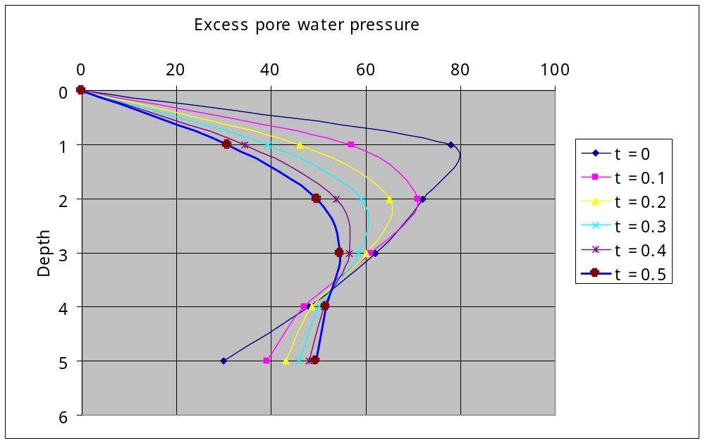
Figure E2.1

Slide 14
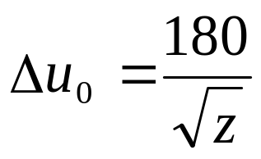
Assignment #2:
1. Redo example 2.1, assuming that the initial excess pore water pressure is distributed according to:

